Slide 1

Realization & Implementation of Communication for Hearing Impaired & Inarticulate People
Presented By: Tanzila Iram
Muhammad Faizan Ikram

Slide 2
Outline
Introduction
Project goal
Implementation plan
Literature review
Work done so far
Machine Learning Models
Way forward
References

Slide 3
Introduction
Natural Language Processing
Human-Computer Interaction & Natural Languages
Sign recognition
Motivation
To remove the disability
To reduce the communication barrier
Sign to speech conversion

Slide 4
Project Goal
The project aims to design a system to communicate with deaf-mute people.
Sign to Speech conversion
Mobile Application Development

Slide 5
Implementation Plan
Sign from Specially-abled person
Sign Videos Pre-Processing
Machine Learning Algorithm
Mobile Application Integration
Mobile Application Integration
Text to Speech Conversion
Text to Speech Conversion
Sign to Text Conversion

Slide 6
Literature Review
Sign to speech conversion using sensor based gloves [1]
KNN Model on sensor based values
Sign word to text conversion[2]
LDA approach
Worked on features extracted by sign images
Desktop application to convert American sign language to speech [3]
Sign language interpretation based on webcam images
Haar Cascade Classifier
Alphabets & numbers to text and speech [4]
Open CV for hand pose detection
CNN model

Slide 7
Literature Review (cont...)
Video classification (CNN-RNN) [5]
CNN (Inception V3, ResNet50) for feature extraction
RNN (GRU) maintains frames sequence & for training on extracted features
Video classification (ConvLSTM) [6]
LSTM (RNN) for temporal information
CNN for spatial information

Slide 8
Work done so far

Slide 9
Data Collection
No. of Subjects | 10
Action categories | 30
Average videos per action | 16
Total Number of videos | 500
Average number of frames per video | 120

Slide 10
Data Collection (Cont...)
Commonly used sentences
Sr. No | Sentences | Sr. No | Sentences
1 | I cannot speak | 16 | Where are you going?
2 | Thank you | 17 | I don’t understand.
3 | Call the ambulance | 18 | No
4 | What is the time? | 19 | Allah Hafiz/Bye
5 | I am a student | 20 | Can you help me?
6 | I need your help | 21 | I am looking for this
7 | Who are you? | 22 | Hi/Hello
8 | Excuse me/I am sorry | 23 | Clock
9 | He is my brother | 24 | Door
10 | What is your name? | 25 | Engineer
11 | How are you? | 26 | Mechanic
12 | I am good | 27 | Emergency
13 | Nice to meet you | 28 | Accident
14 | Leave me alone | 29 | Yes/Alright
15 | I want to go to school/outside | - | -

Slide 11
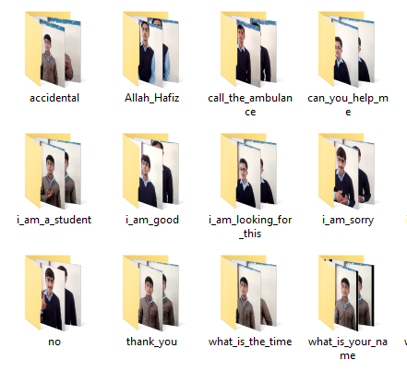
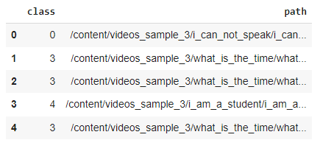
Dataset Preprocessing
Data Acquisition
Data Acquisition
Avg. 17 videos for each sign
Raw video processing and storing dataset in CSV file

Slide 12
Dataset Preprocessing (cont...)
2. Train Test Split
Complete Data
Action categories | 30
Average Number of videos per action | 17
Total Number of Videos | 500
Training Data
Testing Data
Action categories | 6
Total Number of Videos | 75
Action categories | 6
Total Number of Videos | 19
12

Slide 13

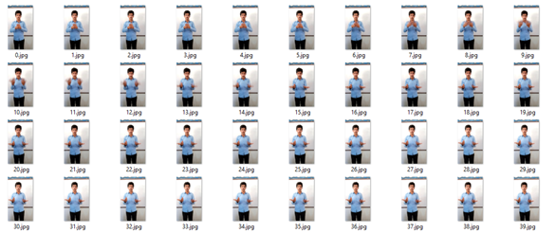
Dataset Preprocessing (cont...)
3. Frame Extraction
OpenCV Library
Capture videos
Read frame by frame
(fps = 30)
Resizing
(224*224)
Normalizing the frames
Storing in Numpy Array

Slide 14
Machine Learning Models

Slide 15
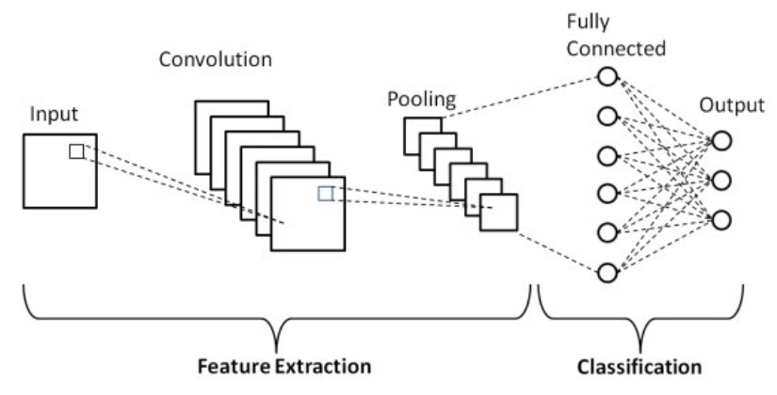
Convolutional Neural Network (CNN)
[7]

Slide 16
Convolution
These are the network parameters to be learned.
1 | 0 | 0 | 0 | 0 | 1
0 | 1 | 0 | 0 | 1 | 0
0 | 0 | 1 | 1 | 0 | 0
1 | 0 | 0 | 0 | 1 | 0
0 | 1 | 0 | 0 | 1 | 0
0 | 0 | 1 | 0 | 1 | 0
Filter 1
1 | -1 | -1
-1 | 1 | -1
-1 | -1 | 1
6 x 6 image

Slide 17
Convolution
Filter 1
1 | -1 | -1
-1 | 1 | -1
-1 | -1 | 1
stride=1
1 | 0 | 0 | 0 | 0 | 1
0 | 1 | 0 | 0 | 1 | 0
0 | 0 | 1 | 1 | 0 | 0
1 | 0 | 0 | 0 | 1 | 0
0 | 1 | 0 | 0 | 1 | 0
0 | 0 | 1 | 0 | 1 | 0
Dot
product
3
-1
6 x 6 image

Slide 18
Convolution
1 | -1 | -1
-1 | 1 | -1
-1 | -1 | 1
Filter 1
stride=1
1 | 0 | 0 | 0 | 0 | 1
0 | 1 | 0 | 0 | 1 | 0
0 | 0 | 1 | 1 | 0 | 0
1 | 0 | 0 | 0 | 1 | 0
0 | 1 | 0 | 0 | 1 | 0
0 | 0 | 1 | 0 | 1 | 0
3
-1
-3
-1
-3
1
0
-3
Feature
Map
-3
-3
0
1
3
-2
-2
-1
6 x 6 image

Slide 19
Max Pooling
Filter 1
3
-1
-3
-1
-3
1
0
-3
x1 | x2
y1 | y2
-3
-3
0
1
3
-2
-2
-1

Slide 20
Max Pooling
New image
but smaller
1 | 0 | 0 | 0 | 0 | 1
0 | 1 | 0 | 0 | 1 | 0
0 | 0 | 1 | 1 | 0 | 0
1 | 0 | 0 | 0 | 1 | 0
0 | 1 | 0 | 0 | 1 | 0
0 | 0 | 1 | 0 | 1 | 0
Conv
3
0
Max
Pooling
3
1
2 x 2 image
6 x 6 image
Each filter
is a channel

Slide 21
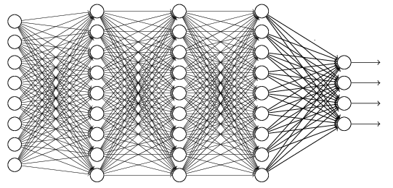
Flattening
3
3
0
0
3
1
1
Flattened
3
Fully Connected Feedforward network

Slide 22
Recurrent Neural Network
(RNN)
Given function f: h’,y=f(h,x)
y¹
y²
y³
h⁰
f
h¹
f
h²
f
h³
……
x¹
x²
x³
Not able to learn long-term dependencies in a sequence
22

Slide 23
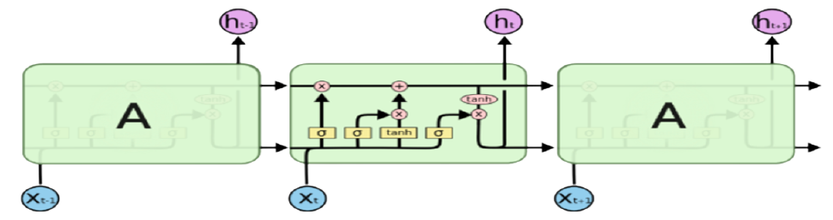
Long Short Term Memory (LSTM)
Long short term memory
Cell state(it)
Forget gate (ft)
Update gate (Ct)
Output gate (Ot)
The model passes the previous hidden state to the next step of the sequence
[8]

Slide 24
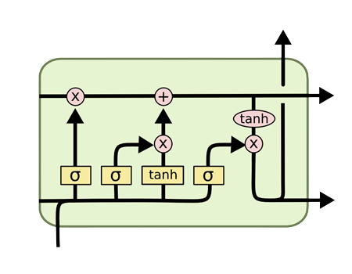
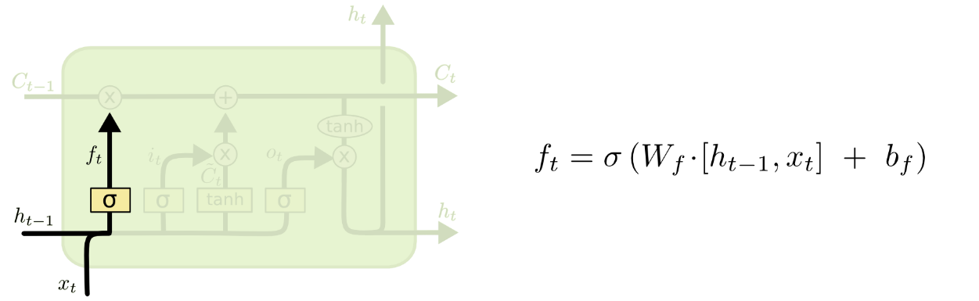
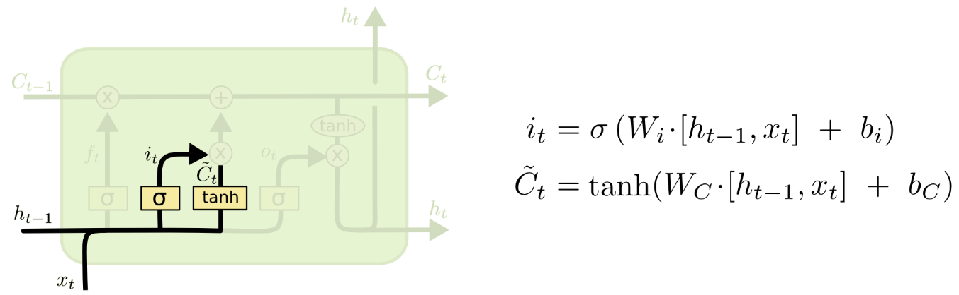
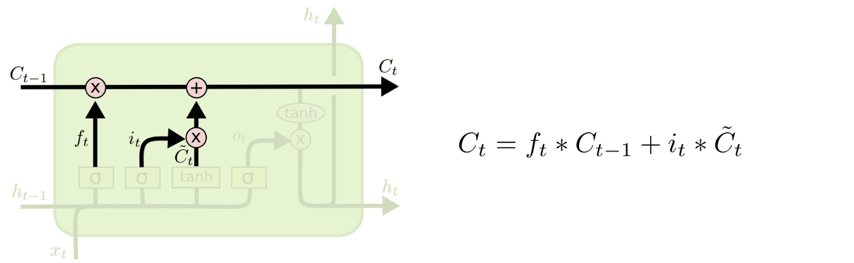
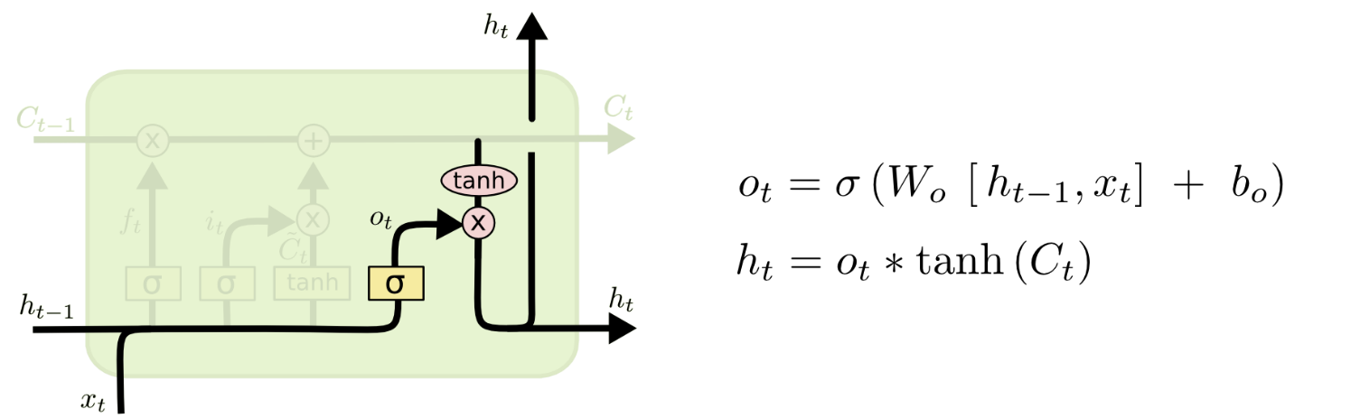
i_{t} decides what component
is to be updated.
C’_{t} provides change contents
Updating the cell state
Decide what part of the cell state to output
[8]
24

Slide 25
ConvLSTM (cont...)
Frames
Convolutional Layers
Flattened 1D array with obtained features
LSTM
Determines the future state of a certain cell by the inputs and past states of its local neighbors
Spatiotemporal

Slide 26
Implemented ConvLSTM Architecture
Input
Output
ConvLSTM
Max Pooling
Max Pooling
ConvLSTM
Flatten
Dense
Time Distributed Dropout
Time Distributed Dropout

Slide 27





Implementation of ConvLSTM
Video-1
Training Dataset
Frames Extraction
Model Training (ConvLSTM)
Video-2
Validation Dataset
Model Evaluation
99%
Video-k
Test Dataset

Slide 28
Results
ConvLSTM
Sr# | Dataset | Accuracy (%) | Loss
1 | Training | 96.5 | 0.3
2 | Validation | 80.7 | 0.9
3 | Testing | 75.0 | 1.0

Slide 29
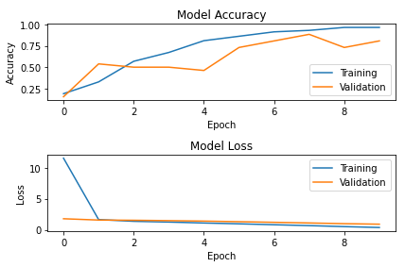
Results
ConvLSTM

Slide 30
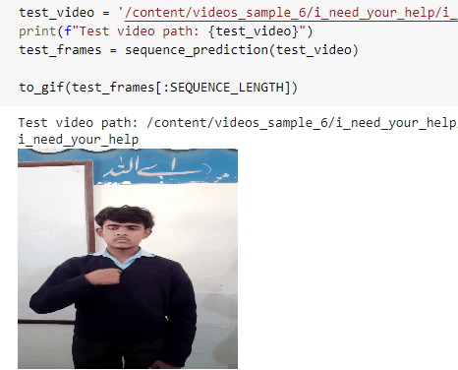
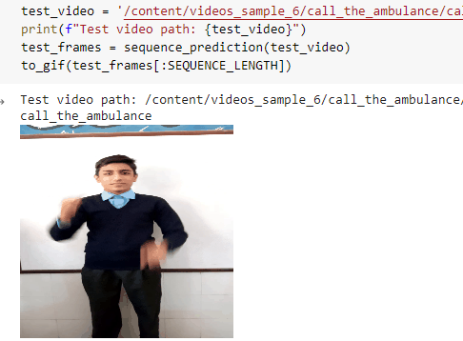
Results
ConvLSTM

Slide 31
Feature Extraction
InceptionV3
ResNet50
48 Convolution layers along with 1 MaxPool and 1 Average Pool layer
48 layers deep Convolutional Neural Network
Pre-trained on ImageNet-1k dataset
Can be used where we have less amount of data.

Slide 32
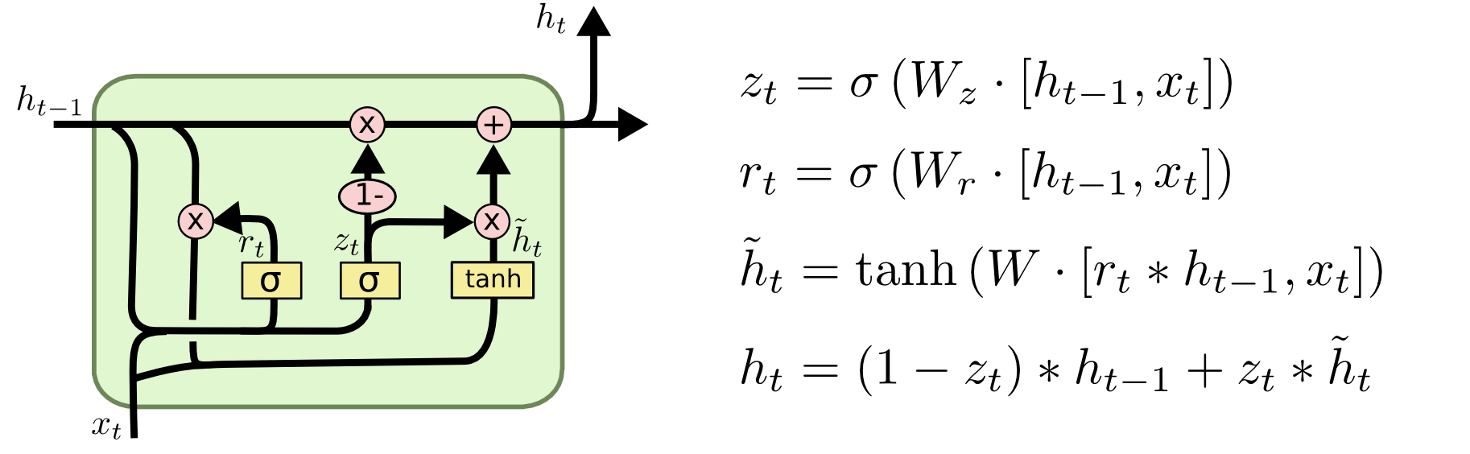
GRU – Gated Recurrent Unit
Reset Gate
Update Gate
Current Memory Cell
Reset gate
Update gate
Current Memory Cell
[10]

Slide 33
Implemented GRU Architecture
Input
Input Layer
Dropout Layer
Output
GRU Layer
GRU Layer
Output Layer
Dense Layer

Slide 34
Implementation of CNN-RNN (ResNet50)
Video-1
Training Dataset
Frames Extraction
Features Extraction
Model Training (RNN)
Video-2
Validation Dataset
Model Evaluation
99%
Video-k
Test Dataset
ResNet50 (CNN)

Slide 35
Results
ResNet50
Sr# | Dataset | Accuracy (%) | Loss
1 | Training | 80.7 | 0.6
2 | Validation | 73.9 | 1.2
3 | Testing | 57.8 | 0.9

Slide 36
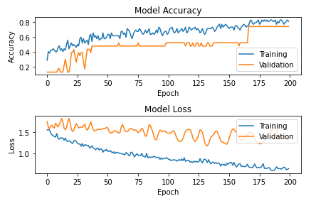
Results
ResNet50
Sr# | Dataset | Accuracy (%) | Loss
1 | Training | 80.7 | 0.6
2 | Validation | 73.9 | 1.2
3 | Testing | 57.8 | 0.9

Slide 37
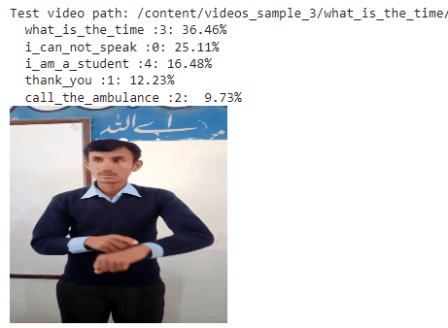
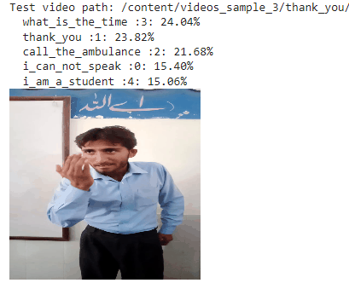
Results
ResNet50

Slide 38
Implementation of CNN-RNN (Inception-V3)
Video-1
Training Dataset
Frames Extraction
Features Extraction
Model Training (RNN)
Video-2
Validation Dataset
Model Evaluation
99%
Video-k
Test Dataset
Inception V3 (CNN)

Slide 39
Results
Inception V3
Sr# | Dataset | Accuracy (%) | Loss
1 | Training | 84.6 | 0.5
2 | Validation | 86.9 | 0.5
3 | Testing | 57.8 | 1.3

Slide 40
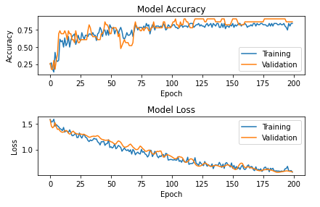
Results
Inception V3

Slide 41
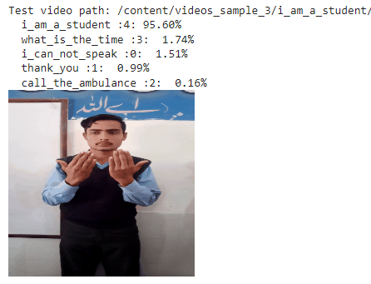
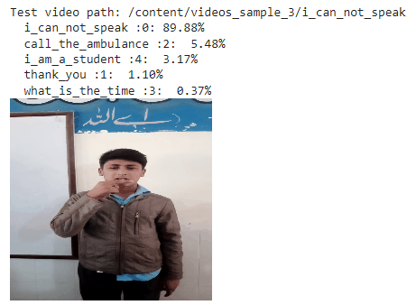
Results
Inception V3

Slide 42
Way Forward
Data collection to improve model accuracy
Mobile Application Architecture
Final Product
Integration with mobile application

Slide 43
References
[1] P. D. Rosero-Montalvo et al., "Sign Language Recognition Based on Intelligent Glove Using Machine Learning Techniques," 2018 IEEE Third Ecuador Technical Chapters Meeting (ETCM), 2018, pp. 1-5, doi: 10.1109/ETCM.2018.8580268.
[2] Mahesh Kumar, “Conversion of Sign Language into Text” International Journal of Applied Engineering Research ISSN 0973-4562 Volume 13, Number 9 (2018) pp. 7154-7161
[3] Mirzaei, M.R., Ghorshi, S. & Mortazavi, M. “Audio-visual speech recognition techniques in augmented reality environments.” Vis Comput 30, 245–257 (2014). https://doi.org/10.1007/s00371-013-0841-1
[4] Sign Language Recognition [Online]. Available at: https://data- flair.training/blogs/sign-language- recognition-python-ml- opencv/
[5] Video Classification [Online]. Available at: https://keras.io/examples/vision/video_classification
[6] Next-Frame Video Prediction [Online]. Available at: https://keras.io/examples/vision/conv_lstm
[7] CNN Architecture [Online]. Available at: https://www.upgrad.com/blog/basic-cnn- architecture/
[8] LSTM architecture [Online] Available at: https://stats.stackexchange.com/questions/222584/difference-between-feedback-rnn-and-lstm- gru
[9] An Introduction to convLSTM [Online] Available at: https://medium.com/neuronio/an- introduction-to-convlstm-55c9025563a7
[10] GRU Architecture [Online]. Available at: https://clay-atlas.com/us/blog/2021/07/27/gru-en- introduction-note/

Slide 44
Thank You!
Video Demonstration

